Slide 1
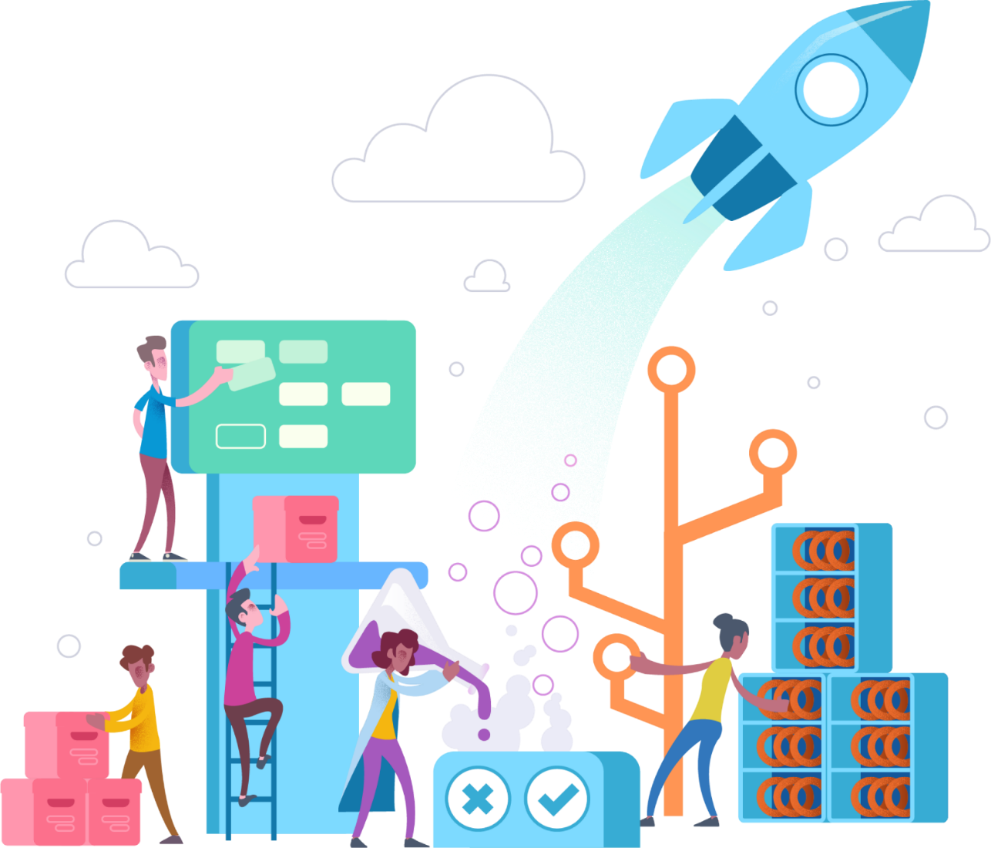

Introduction to Azure DevOps DevOps: Practices and Principles
By: Tariq Abubaker
Based on Microsoft Coursers and slides:
DevOps: Practices and Principles by Steven Borg and Sam Guckenheimer
DevOps: An IT Pro Guide by David Tesar and Morgan Webb

Slide 2
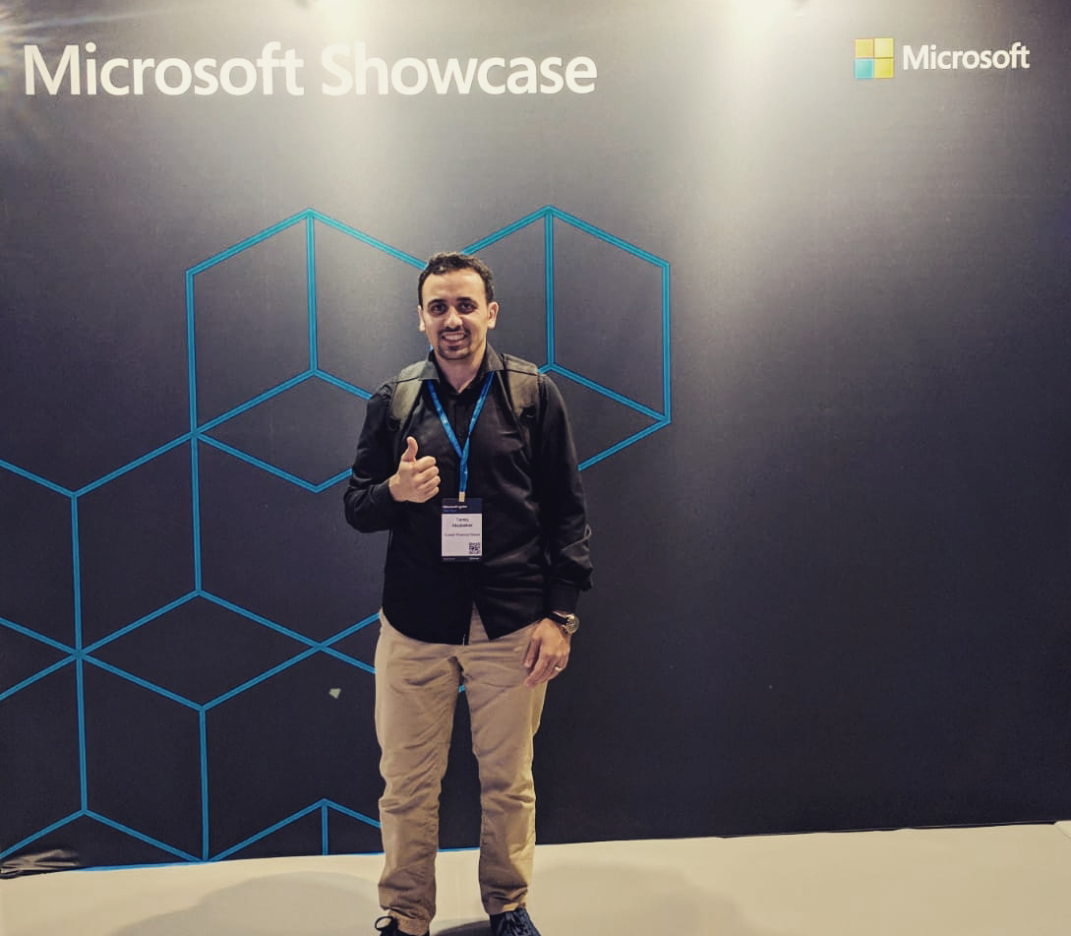


Tariq Abubaker
Overview
IT Enterprise Architect for Kuwait Finance House.
+10 years of experience in the IT and banking industry. I participated multiple projects range from SOA, EA, Core banking, Payment Solutions, Credit Cards, AML and Fraud, CRM, Retail, Finance, and IT service management solutions.
Certifications
TOGAF® 9 Certified.
DevOps Certified.
MCTS: .NET Framework 4, Web Applications.
MCP
Contact Details
https://www.linkedin.com/in/tariq-abubaker/
@taq_abubaker

Slide 3
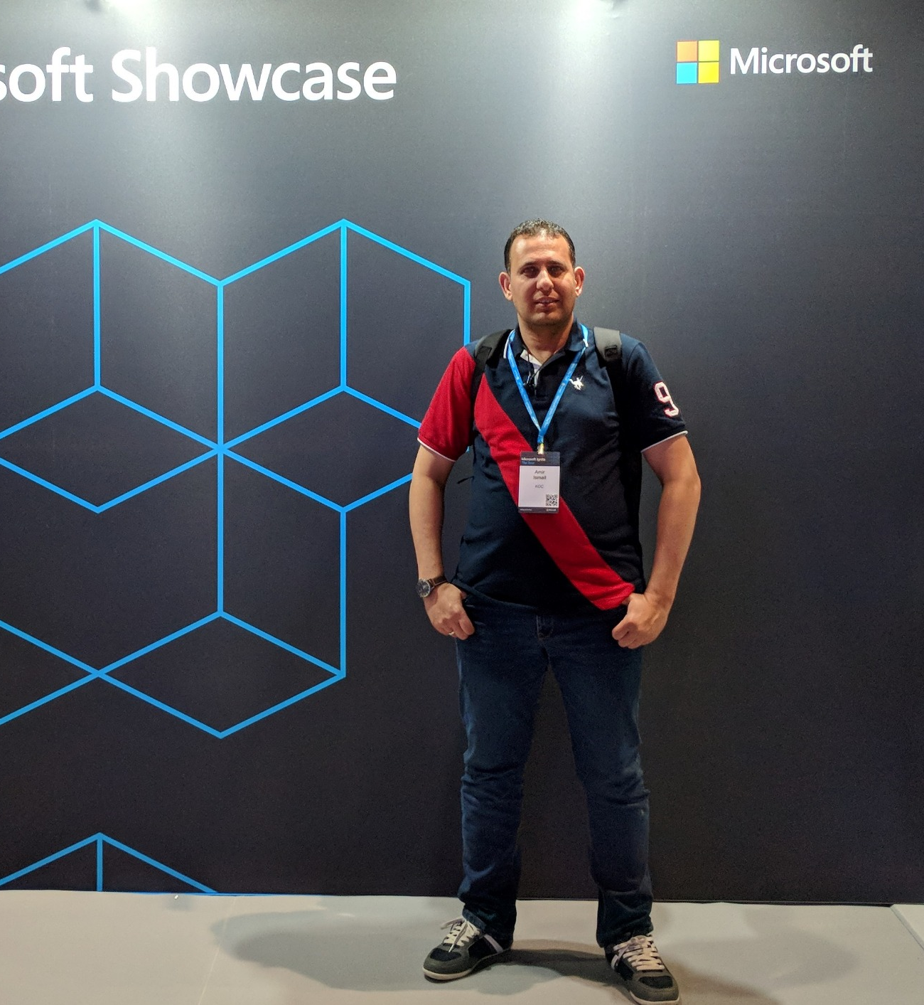
Amir Ismail
Overview
Senior Software Engineer for Kuwait Oil Company.
+15 years of experience in Software Engineering. I participated in multiple projects in different business domains range from E-learning, Banking, Oil, E-booing and Hotels management.
Certifications
PSM I Certified.
ITIL® Certified.
PRINCE2® Certified.
Contact Details
https://www.linkedin.com/in/amirismailyousef/
@miroprocessor

Slide 4
Last Month Update
Azure Kuwait
.NET Kuwait

Slide 5
Agenda & Topics
Introduction to Azure DevOps DevOps: Practices and Principles
01 | Introduction & DevOps Fundamentals | 04 | Continues Learning
02 | Building and Deploying to Production
03 | Testing Automatically

Slide 6
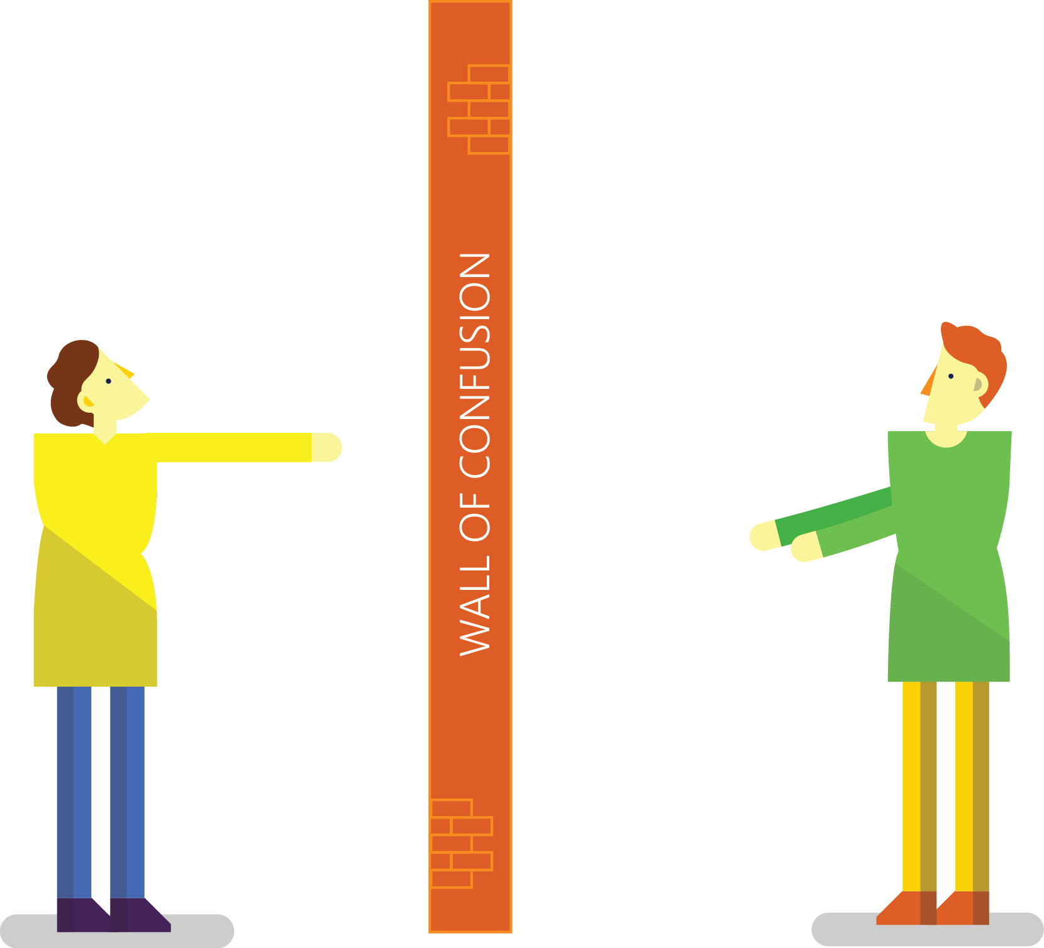

Traditional Development and Operations
DEV
OPS
Notes:
Taken from: http://dev2ops.org/2010/02/what-is-devops/
Development kicks things off by “tossing” a software release “over the wall” to Operations. Operations picks up the release artifacts and begins preparing for their deployment. Operations manually hacks the deployment scripts provided by the developers or creates their own scripts. They also hand edit configuration files to reflect the production environment, which is significantly different than the Development or QA environments. At best they are duplicating work that was already done in previous environments, at worst they are about to introduce or uncover new bugs.
Operations then embarks on what they understand to be the currently correct deployment process, which at this point is essentially being performed for the first time due to the script, configuration, process, and environment differences between Development and Operations. Of course, somewhere along the way a problem occurs and the developers are called in to help troubleshoot. Operations claims that Development gave them faulty artifacts. Developers respond by pointing out that it worked just fine in their environments, so it must be the case that Operations did something wrong. Developers are having a difficult time even diagnosing the problem because the configuration, file locations, and procedure used to get into this state is different then what they expect (if security policies even allow them to access the production servers!).
Time is running out on the change window and, of course, there isn’t a reliable way to roll the environment back to a previously known good state. So what should have been an eventless deployment ended up being an all-hands-on-deck fire drill where a lot of trial and error finally hacked the production environment into a usable state.

Slide 7



Resolving issues without DevOps
There is no problem with my code, you’re either deploying wrong or there is a problem with your infrastructure.
Infrastructure looks good, must be a code problem.
Customer finds problem with your application.
Operations gets notified of application problem.
DEV
OPS
Notes:
Pager image: http://www.medicoland.eu/ru/pager&page=4

Slide 8

Conflicts across Dev, Ops, and Business
Ops: “You’re losing us money with all these outages!”
Dev: “I need 5 more features on the application by next week.”
You’re causing me outages with all your frequent updates to production… behind my back!
I’m just trying to crank out the code quickly to keep the boss happy. You’re only slowing me down!
BUSINESS
OPS
DEV
Notes:
Dev: “What’s the point of an Agile development process, that produces production ready code every two weeks, if the code sits for weeks or months waiting to be released?”
IT/Ops: “These frequent releases are killing my team, and impacting our ability to have a stable environment!”

Slide 9

What some businesses do
NEW “DEVOPS” GUY

Slide 10
So What Is DevOps?

Slide 11

“DevOps is development and operations collaboration”
“DevOps is treating your infrastructure as code”
It’s DevOps!
It’s DevOps!
“DevOps is using automation”
It’s DevOps!
“DevOps is feature switches”
It’s DevOps!
“DevOps is small deployments”
“Kanban for Ops?”

Slide 12
DevOps Definition
DevOps is the union of people, process, and products to enable continuous delivery of value to our end users.
You cannot buy DevOps and install it. DevOps is not just automation or infrastructure as code. DevOps is people following a process enabled by products to deliver value to end users.
Donovan Brown
Microsoft DevOps Program Manager

Slide 13


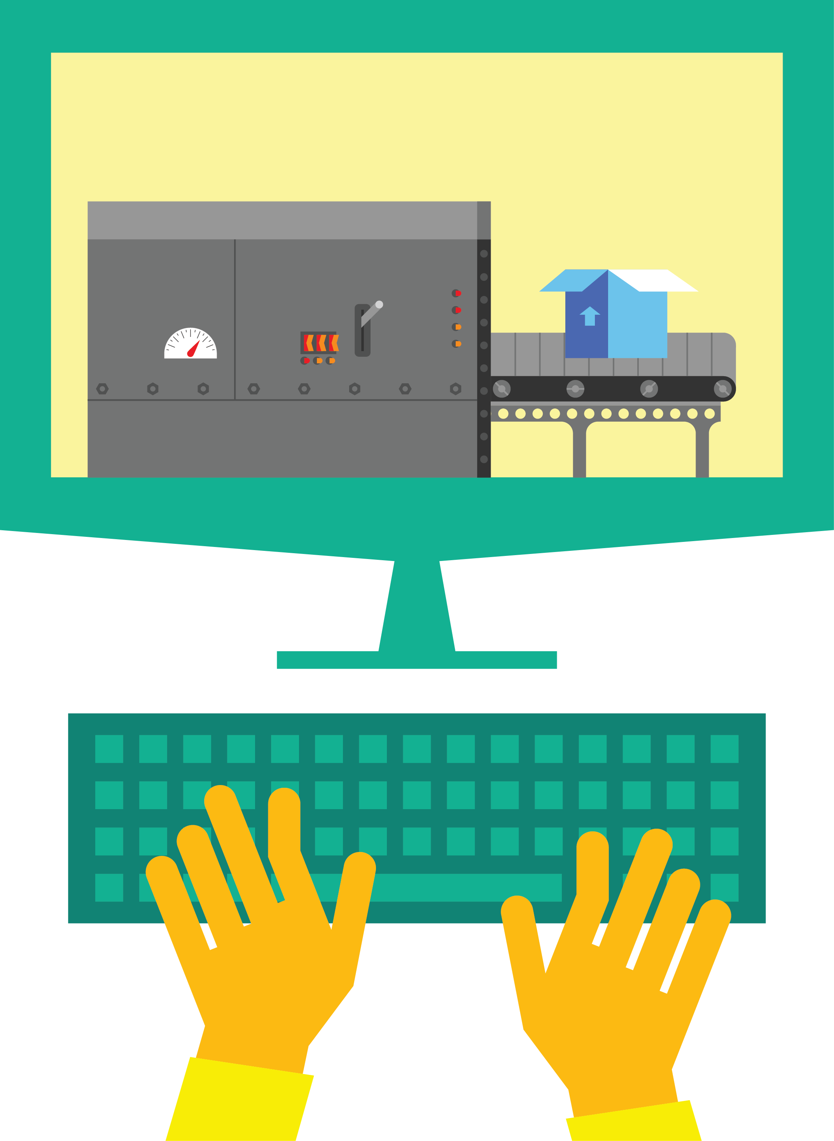

DevOps: The Three Stage Conversation
1
People
2
Process
3
Products
Notes:
People = Culture
Fundamental attributes of successful cultures:
Shared mission and incentives: infrastructure as code, apps as services, DevOps/all as teams
You need to consider your hardware as a commodity, (don't give your servers names) , servers are like farm animals, it is just harder if you let theids name them
Build deep instrumentation into services, push complexity up the stack
Rally around agile, shared metrics, CI, service owners on call, etc.
Changing the culture: any change takes time, changing culture is no exception and you can't do it alone, exploit compelling events to change culture: downtimes, cloud adoption, devops buzz
PROCESS Definition and design, compliance, and continuous improvement
PEOPLE Responsibilities, management, skills development, and discipline
Products Tools and infrastructure

Slide 14
People/Process is what % of downtime?
PROCESS
OPERATIONS
APPLICATION FAILURE
OPERATOR ERROR
Change management
Overloaded
Weak problem detection
Forget something
Lack of procedures
Backup errors/security
40%
40%
OTHER
20%
Hardware/OS
Network
Power and disaster
Gartner Security Conference presentation "Operation Zero Downtime," D. Scott
Notes:
Organizations must recognize that people, process, and technology are all interdependent facets of all IT services.
As noted by Gartner above, 80% of operational problems can often be attributed to people and process issues. Only a portion of the remaining 20% is actually technology related – some being external disasters.

Slide 15
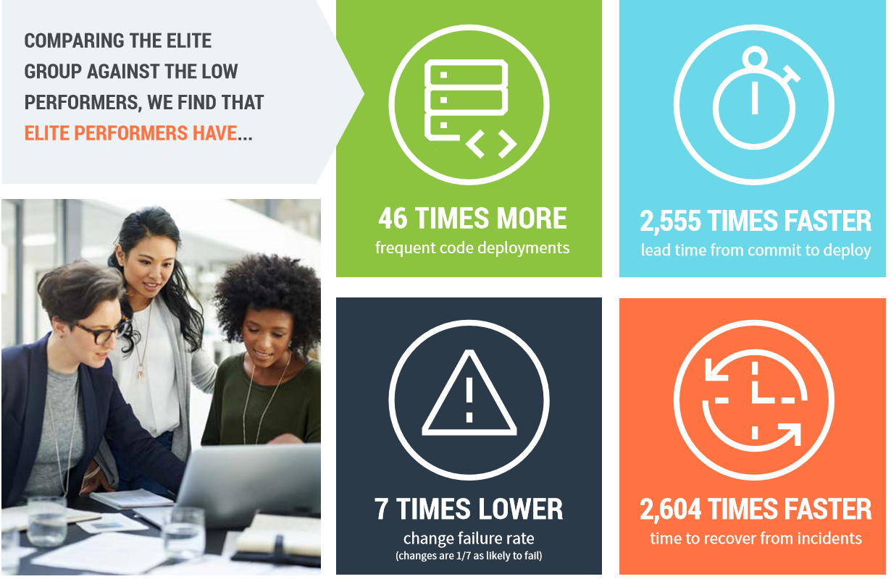

2018 State of DevOps Report Says…

Slide 16
DevOps at Scale
Azure DevOps is the toolchain of choice for Microsoft engineering with over 100,000 internal users
➔
https://aka.ms/DevOpsAtMicrosoft
442k
Pull Requests per month
4.6m
Builds per month
28k
Work items created per day
82,000
Deployments per day
2.4m
Private Git commits per month
3.5k Open Source repos
12k
Employees contributing to open source
Data: Internal Microsoft engineering system activity, March 2019
Notes:
Enterprise scale

Slide 17
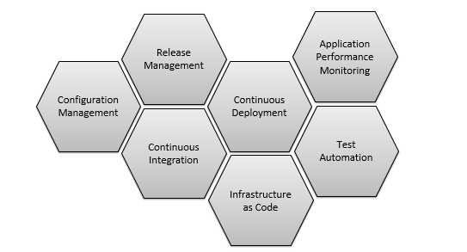
DevOps Practices
Configuration management
Infrastructure as Code
Test automation
Continuous Integration (CI)
Continuous Deployment (CD)
Release management
Application performance monitoring

Slide 18
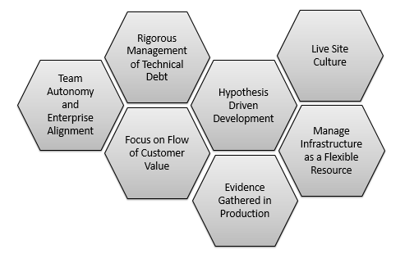
DevOps Habits
Live-site culture
Focus on value stream
Hypothesis-driven development
Evidence gathered in production
Team autonomy and enterprise alignment
Rigorous management of technical debt
Manage infrastructure as a flexible resource

Slide 19

ALM framework
Source
Build
Deployment
Application
Operations
Cloud
Test/issues
On-premises
Process tools

Slide 20
Agenda & Topics
Introduction to Azure DevOps DevOps: Practices and Principles
01 | Introduction & DevOps Fundamentals | 04 | Continues Learning
02 | Building and Deploying to Production
03 | Testing Automatically

Slide 21
Local Builds vs. Automated Builds
Local builds are usually considered to be defined as the process of building on your local machine through an IDE before you check in changes. It might run some tests if they are in the solution of your main code, but it won’t publish results and just compile the code.
Automated builds you set up either a build machine or use a hosted build platform to compile and test code, package the code, run scripts, or publish to a shared drop folder or feed. Depending on the build system you use, you install build agents on the specific machine on which you want to run builds, make sure that software dependencies are installed on the machine, and tie the build agents back into the main build system.
In DevOps, automated builds are an integral part of continuous integration (CI)

Slide 22
Continuous Integration
CI is the practice of merging all developer working copies to a shared code line several times a day, and validating each integration with an automated build. In practice, CI is often defined as having a build with unit tests that executes at every commit or check-in to version control.
CI provides many benefits, including:
Improving code quality based on rapid feedback.
Triggering for automated testing for every code change.
Better managing technical debt and conducting code analysis.
Reducing long, difficult and bug-inducing merges.
Increasing confidence in code long before production.

Slide 23
Demo

Slide 24
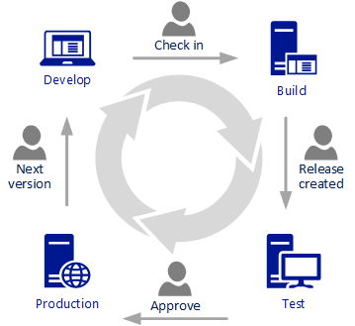
Continuous Delivery
Continuous delivery is a software engineering approach in which teams produce software in short cycles to ensure that software can be reliably released at any time. It aims to build, test, and release software faster and more frequently.
This method reduces the cost, time, and risk of delivering changes by allowing for more incremental updates to production.
In practice, continuous delivery is realized through an automated deployment pipeline, which might have one or more manual approval gates prior to reaching production.
CD:
Encourages Infrastructure as Code and configuration as code.
Enables automated testing throughout the pipeline.
Provides visibility and fast feedback cycles.
Makes going to production a low-stress activity.

Slide 25
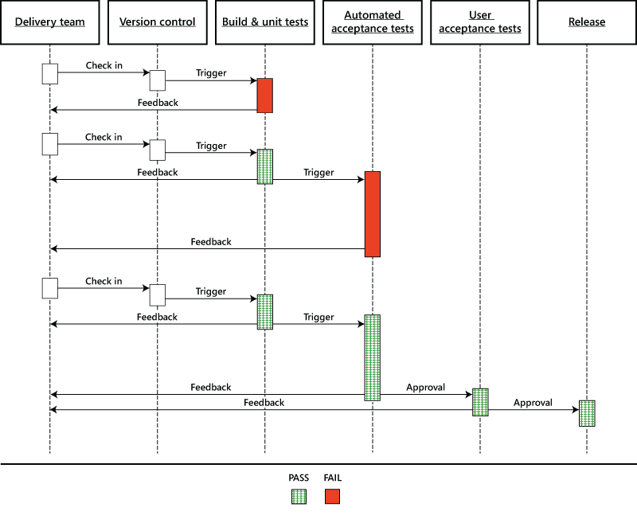
Conceptualizing a Release Pipeline

Slide 26
Demo

Slide 27
Agenda & Topics
Introduction to Azure DevOps DevOps: Practices and Principles
01 | Introduction & DevOps Fundamentals | 04 | Continues Learning
02 | Building and Deploying to Production
03 | Testing Automatically

Slide 28
Automated Testing
A key question developers face is this: How can I ensure a continuous release cadence while maintaining a high quality bar? The answer lies in automated testing.
Automated testing helps developers run tests early and often to ensure that they are testing their software quality continuously and making sound decisions whether to release their product or not. Test automation has various benefits, including but not limited to obtaining early feedback, shortening the release cycles, reducing cost, measuring quality continuously, avoiding regressions, shipping high quality product, and finally, making their customers happy.
It is important to note that test automation should be done in the right way and at the right time to ensure a high-quality release.

Slide 29
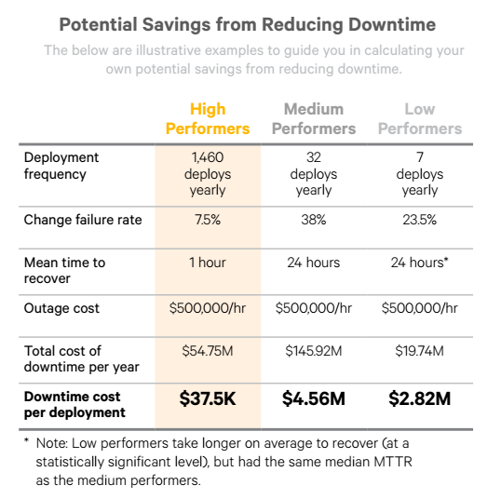
Value of Automated Testing
Early and timely feedback.
Speeds up software delivery.
Reduces cost.
Reliability.
Repeatability.
Robust testing architecture.
Fundamental to CI/CD
approach in DevOps.

Slide 30
Agenda & Topics
Introduction to Azure DevOps DevOps: Practices and Principles
01 | Introduction & DevOps Fundamentals | 04 | Continues Learning
02 | Building and Deploying to Production
03 | Testing Automatically

Slide 31
Continuous Learning
Application Performance Monitoring.
Exposure Strategies
Hypothesis-Driven Development (Experimental)

Slide 32
Application Performance Monitoring
Seeing problems as they occur is the most effective way of making sure that the problems are corrected as soon as possible. A system that is able to monitor, detect, and alert to problems will allow for mitigation or resolution of problems as soon as they occur.
It is important to use feedback to learn. Obtaining feedback enables us to achieve several objectives:
Quality
Reliability
Safety
Delivery of value to users

Slide 33
Exposure Strategies - Feature Flags
A feature flag is a conditional in your code, an if then for two different options. At its simplest, a feature flag can be used to flag a new or risky behavior. First, the feature is deployed off. Then, separate from deployment, you can turn on the new feature.
If the feature doesn’t behave as expected, it is possible to shut it off quickly. This is better than rolling back an entire version because you have isolated the change.
Feature flags are effective for risk mitigation, fast feedback, hypothesis-driven development, and long-term control. There’s no one right way to use feature flags.

Slide 34
Exposure Strategies – Blue/Green Deployments
Blue-green deployments are based on two identical production environments. The key is to ensure that the two environments are truly identical, including the data that they manage. Zero-downtime releases are achieved by deploying to the blue environment. After the new deployment is smoke tested, traffic is routed to the green environment, which then becomes the production environment.
DevOps encourages a cultural shift of releasing quickly for fast feedback cycles.
This process works for code only. The database is typically a single environment, because having two matching databases in which the replica of the active one changes every time you switch requires a complicated setup.

Slide 35
Exposure Strategies - Canary Releasing
Addresses the challenge of testing a new release with only a subset of servers. A small percentage of users are routed to the new service, while the majority still works against the old version.
Team can begin to release the new version to more and more servers and route more users to it. After all users have migrated to the new version, you can decommission the old version. If after decommissioning the old version problems arise with the new version, the strategy is to once again route users to the old version.
While blue-green deployments are relatively simple, canary releases are more complicated because all instances within a website are based on the same deployment.

Slide 36
Hypothesis-Driven Development
The idea is that unlike in the past, when we thought that a product owner was capable of identifying the user stories, or features, or requirements, and prioritizing them on behalf of all the external factors.
We realize that it's not about what someone thinks. It's not about an opinion. It's about data!
Think of the backlog not as consisting of requirements, not consisting of a necessarily truthfully prioritized backlog. It isn't prioritized in terms of how we will work on it but we don't know the value of those things until we measure them.

Slide 37

Thanks for joining us! Begin your journey with Azure DevOps and GITHUB!
https://aka.ms/AA6oeg6

Slide 38

SCAN THE CODE & SEND US YOUR FEEDBACK!
https://www.surveymonkey.com/r/BH77DPB
38

Slide 39
Questions? Thank you

